Slide 1

Electronic's shop
Group Project

Slide 2
TEAM A: GROUP MEMBERS
Francisco Ekang Mofuman
Francisco Esteban Ndong Nengono
Joaquin Afugu Ntoo
Jose Angel Nguema Azeme

Slide 3
INTRODUCTION
1. Problem Identification: Why an electronics store?
-To make the process of purchasing items easier and handy
2. Program's requirement: What does the program do?
- The program executes store operations
3. Overview of detailed Design: Solution implementation?
- Stack, Queue, linked list, and other functions.
4. Solution Approach: Software benefits and advantages
- Reduce processing time, more control, more security.

Slide 4
DESCRIPTION
This is an interactive C++ program that represents a store that contains a series of items in the stock offered to costumers, and a series of functions that the costumer can perform. It allows them to see the items for sale, buy, and return an item.
This is an online store, which makes available, to costumers, a series of items for sale, and performs functions according to what the user decides.

Slide 5
OBJECTIVES
Wise management : Good organization
Efficiency: Not wasting time or space in memory
Flexibility: to grow in size and complexity
Reusability: The program can be used in different online stores

Slide 6
PROGRAM DETAILED SPECIFICATION
This program will be implemented from two standpoints: from the costumer and the owner view
Store/Owner:
1. See stock Items
2. Add new item to the stock
3. Remove an item
4. Update stock
Customer:
1. Search items
2. Add items to the bag
3. See the list of item in the bag
4. Check out
5. Remove an added item
6. Return an item
7. See the order list

Slide 7
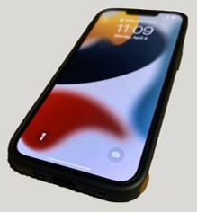
SPECIFICATION FROM SELLER VIEW
1. See stock Items
Array or linked list
2. Add new item to the stock
Stack
3. Remove an item
Stack
4. Returned items list

Slide 8
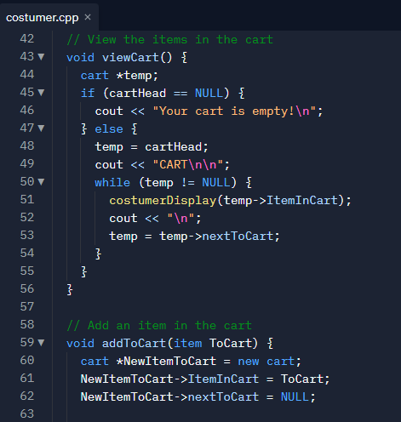
SPECIFICATION FROM CUSTOMER VIEW
1. Search items
Linked list
Binary search tree
2. Add items to the cart
Queue
3. See the list of item in the cart
Queue
4. Check out
Pay selected item
5. Remove an added item
Queue
6. Return an item
See the order list
Add new item to the stock
7. See the order list
Stack

Slide 9
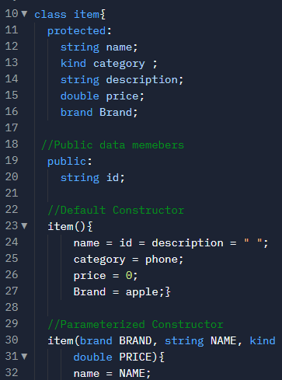
ITEM
Item name
Category
ID
Description
Price

Slide 10
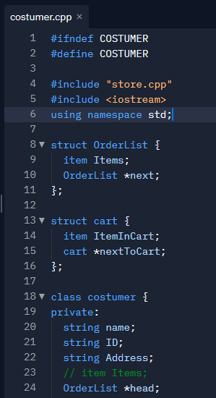
CUSTOMER
Data Members
Name
Sale ID
address
Function Members
See the order list
See the list of item in the bag
Returned an items list

Slide 11
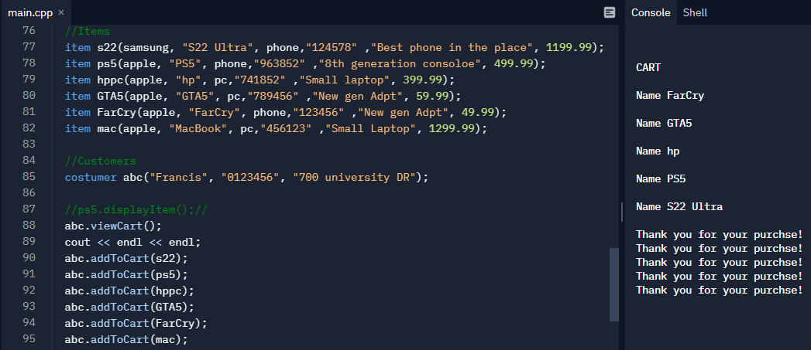
https://replit.com/@FrancisEl/demo-4#seller.cpp

Slide 12
THANK YOU

